Slide 1

Classes and Structure in Object-Oriented Programming with C++
Mastering the building blocks of modern software development
Submitted to: Ms.Jyoti Rani
Designation: Assistant professor
Submitted by: Adarsh singh
Uid: 24BCA10542
Section: 3A (BCA)

Slide 2
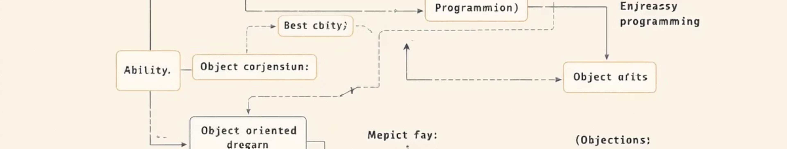



What is Object-Oriented Programming (OOP)?
Real-World Modeling
Modular Design
Core Principles
Programming paradigm that uses objects to represent and model real-world entities and their interactions
Groups data and functions together into cohesive units, creating reusable and maintainable code structures
Built on fundamental concepts: Classes, Objects, Encapsulation, Inheritance, Polymorphism, and Abstraction

Slide 3
Understanding Classes in C++
A class serves as a user-defined blueprint for creating objects, defining both the properties (data members) and behaviors (member functions) that objects of that type will possess.
class Car {public: int speed; string model; void drive() { cout << "Driving!"; } void brake() { speed = 0; }};
Key Characteristics
Defines structure and behavior patterns
Contains data members (variables) and member functions (methods)
No memory allocated until instantiation occurs
Supports access control through specifiers

Slide 4




Objects: Instances of Classes
Class Blueprint
Instantiation
Object Created
Abstract template defining structure
Creating concrete instances from blueprint
Independent entity with its own data
Creating and Using Objects
Each object maintains its own copy of data members while sharing the class methods. Objects interact by invoking each other's member functions.
Car myCar;myCar.speed = 100;myCar.model = "Tesla";myCar.drive();

Slide 5

Encapsulation: Data Hiding and Protection
Encapsulation bundles data and the functions that operate on that data into a single unit, while controlling access to protect internal state.
01
02
Bundle Data & Methods
Apply Access Specifiers
Group related variables and functions together within a class structure
Use private, public, and protected keywords to control visibility
03
Implement Getters/Setters
Provide controlled access through public methods that validate and manage data
class Car {private: int speed; // Protected data public: int getSpeed() { return speed; } void setSpeed(int s) { if (s >= 0) speed = s; }};

Slide 6
Constructors: Initializing Objects
Constructors are special member functions that execute automatically when an object is created, ensuring proper initialization of data members.
class Car { int speed; public: // Default Car() { speed = 0; } // Parameterized Car(int s) { speed = s; } // Copy Car(const Car &c) { speed = c.speed; }};
Default Constructor
1
No parameters, sets initial default values for all data members
Parameterized Constructor
2
Accepts arguments to initialize data with specific values at creation
Copy Constructor
3
Creates new object as copy of existing object

Slide 7




Inheritance: Reusing and Extending Classes
Inheritance enables creation of new classes (derived) that inherit properties and methods from existing classes (base), establishing hierarchical relationships.
Base Class
Parent class with common properties and methods shared across derived classes
Derived Class
Child class that inherits base features and adds specialized functionality
Extended Hierarchy
Multiple levels of inheritance creating rich class relationships
class Car {protected: int speed;public: void drive() { cout << "Driving..."; }};class ElectricCar : public Car { int batteryLife;public: void charge() { batteryLife = 100; }};

Slide 8








Polymorphism: Many Forms, One Interface
Compile-Time
Run-Time
Function and operator overloading resolved during compilation
Virtual functions and overriding determined during execution
Extensibility
Flexibility
Easy to add new types without changing existing code
Same interface supports different implementations
Example: Function Overriding
class Animal {public: virtual void makeSound() { cout << "Generic sound"; }};class Dog : public Animal {public: void makeSound() override { cout << "Woof!"; }};

Slide 9
Class Structure Summary
Header Files (.h)
Source Files (.cpp)
The 'this' Pointer
Memory Allocation
Contains class declarations with member variables and function prototypes using access specifiers
Implements the actual logic and functionality of member functions declared in headers
Special pointer referring to the current object, used to access members and distinguish from parameters
Memory is allocated on the stack or heap only when objects are instantiated, not at class definition

Slide 10

Why Use Classes and OOP in C++?
Natural Modeling
Mirrors real-world entities and relationships, making complex problems easier to conceptualize and solve
Code Reusability
Write once, use many times through inheritance and composition, dramatically reducing development time
Easy Maintenance
Encapsulation isolates changes, making code easier to update, debug, and extend over time
Scalability
Modular structure supports growth from small projects to enterprise-level applications seamlessly
"Object-oriented programming is the foundation of modern software development, enabling developers to build robust, maintainable, and scalable applications in C++."

